Slide 1
Industry: Exercise I. Interesting games
Joel Herraiz Martí

Slide 2
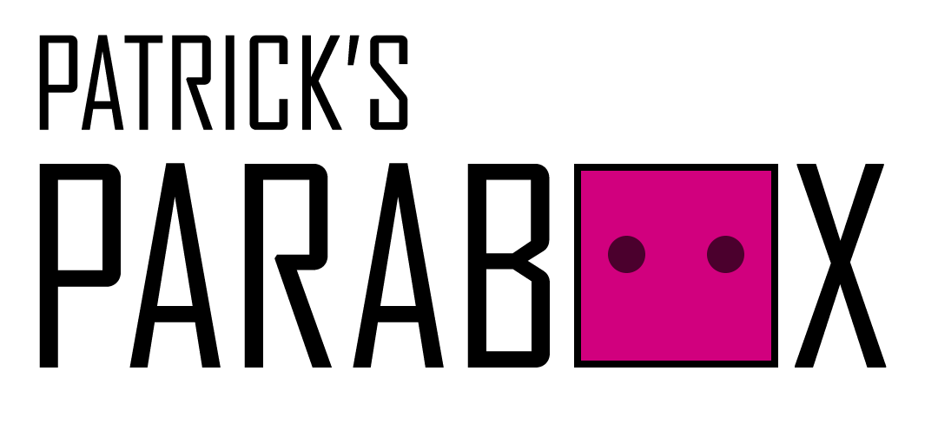
Patrick’s Parabox
Made by indie developer: Patrick Traynor.
Indie game awarded with Excellence in Design Winner in IGF 2020 and Developers Choice Winner in IndieCade 2019.
Made with Unity.
Free demo on Steam: https://store.steampowered.com/app/1260520/Patricks_Parabox/
In development: Release Early 2022.

Slide 3
Patrick’s Parabox
Puzzle Game.
Each level features several puzles that need to be solved in order to complete it.
Player has to move boxes to specific locations to complete each challenge.
Uses Recursivity as a mechanic.
Player actions:
Movement
Undo
Reset

Slide 4
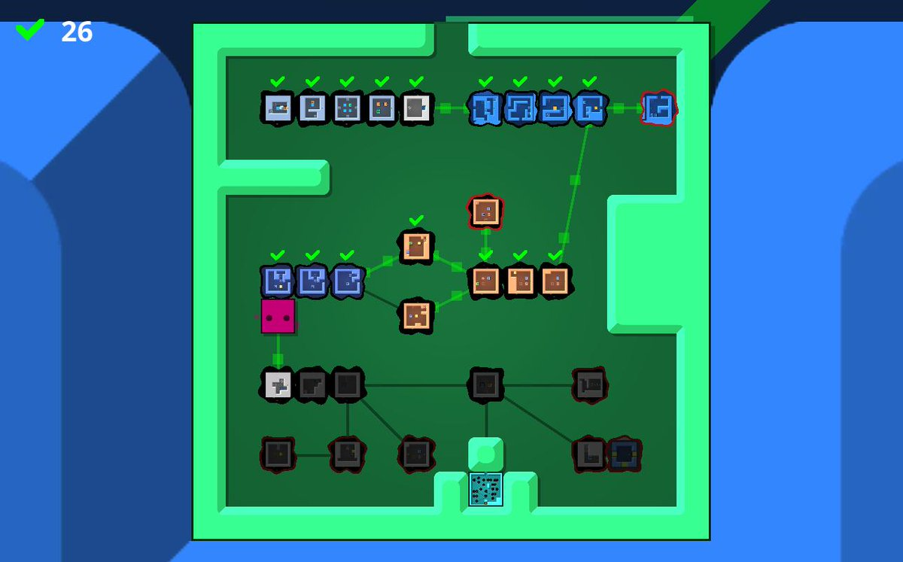
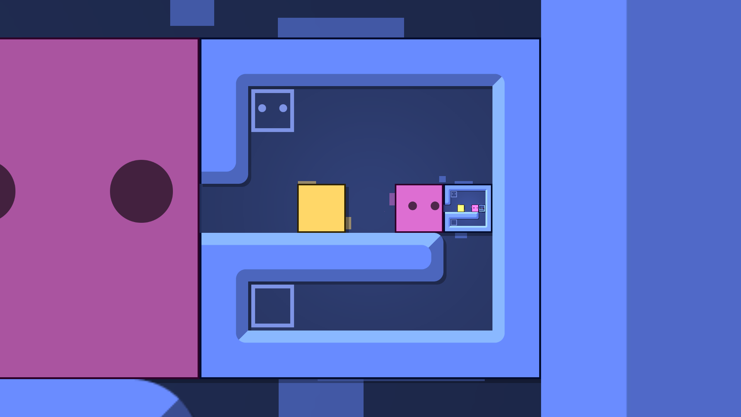
Patrick’s Parabox
Patrick’s Parabox: Complete level
Patrick’s Parabox: Recursive puzzle

Slide 5
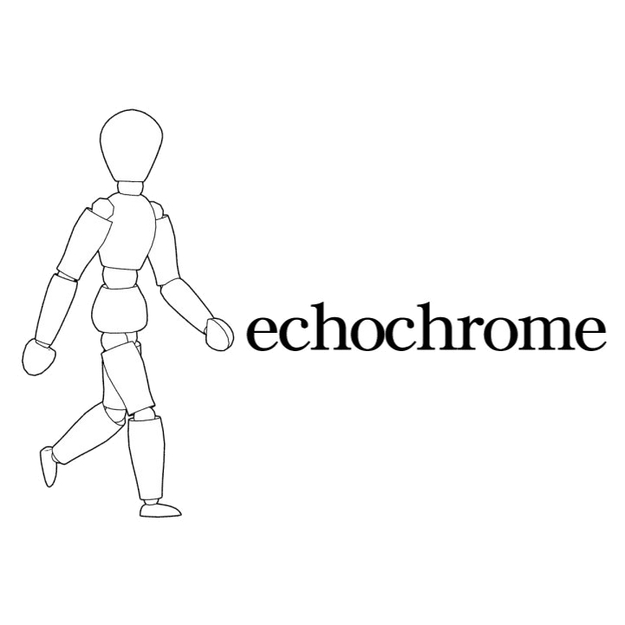
Echochrome
Developed by Japan Studio and Game Yarouze and published by Sony for PS3 and PSP.
Relatively big development.
Announced in 2007’s E3 and released in 2008.
Was available in Play Station Store for PS3.
Player actions:
Move character
Move camera

Slide 6
Echochrome
Puzzle Game
Features levels where player must help the character reach a certain part of the space.
Player must play with the camera perspective in order to give the same 3D scene a different 2D interpretation.
E.g: Covering a pitfall with a column, hiding it from the players view allows the character to walk over it as if there wasn’t a pitfall in his way.

Slide 7
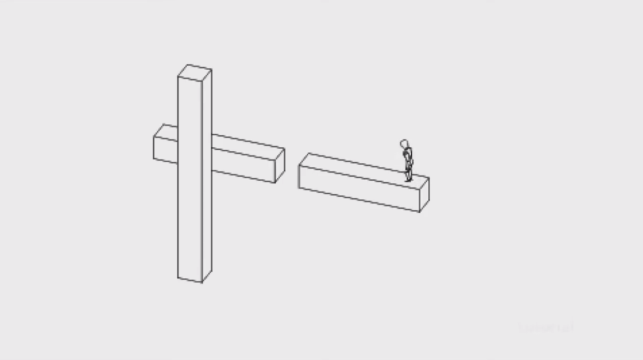
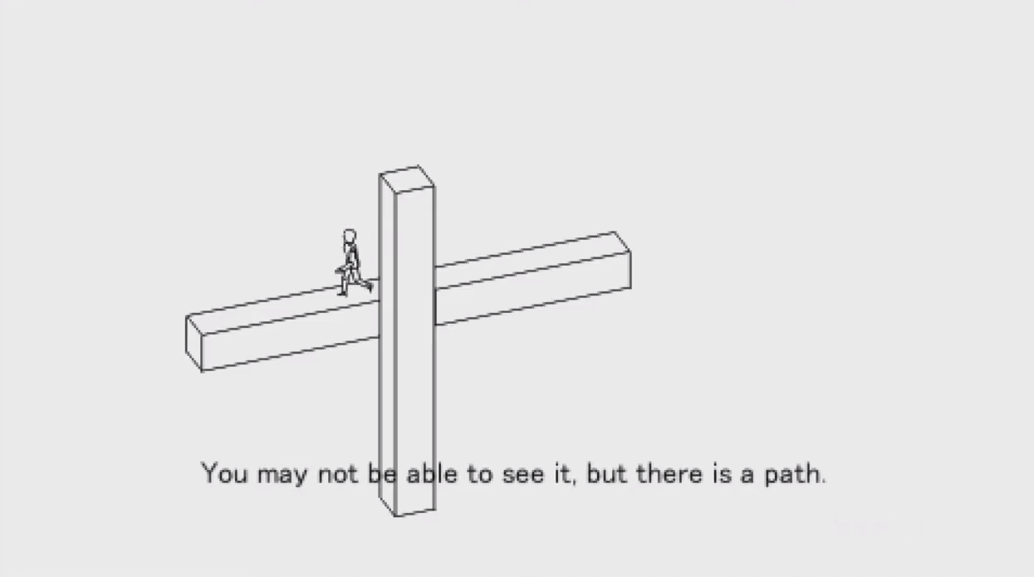
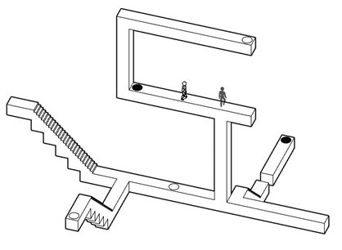
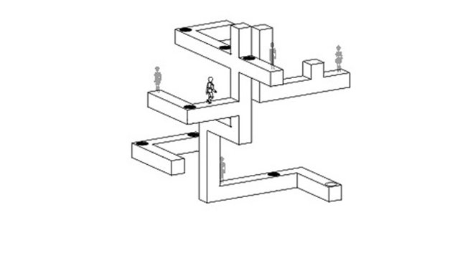
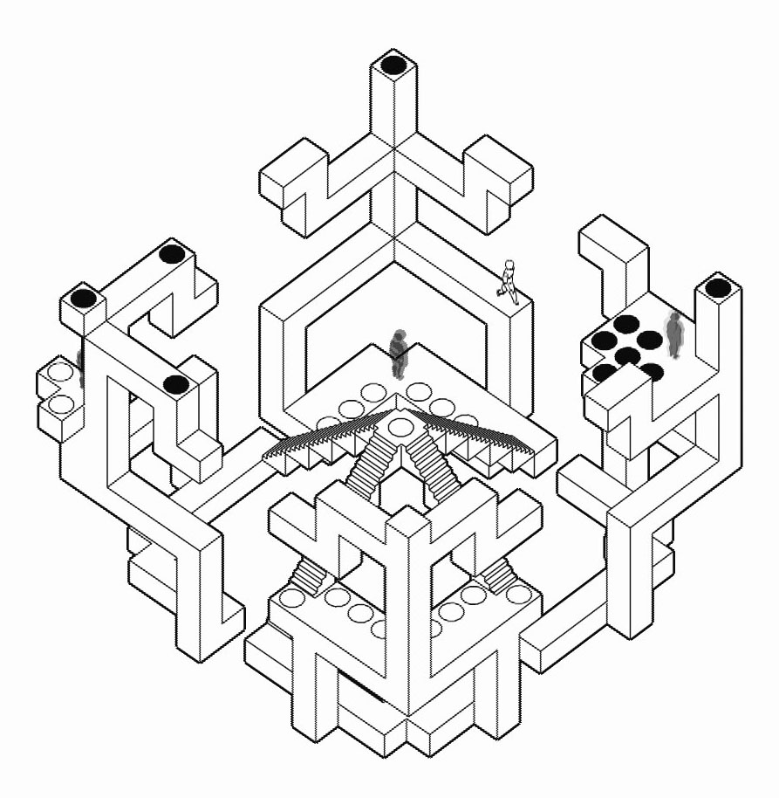
Echochrome

